Slide 1


Representing Adaptive Spacecraft Guidance Policies with Large Language Models in the Earth–Moon CRTBP
Researcher: Daniel Amaya (MS) Advisors: Hiroyasu Tsukamoto (PhD), Siyi Xu (PhD)
8/26/2026
Notes:
The purpose of this talk is to introduce the audience to your summer research project. Please practice for time, as you will have three minutes to complete your entire presentation.

Slide 2


Introduction
Daniel Amaya
N-ACXIS
UIUC 26
ME 597 Independent Study
GRAINGER ENGINEERING
Notes:
Please use this slide to introduce yourself. Include a headshot and/or images of your school/hometown.

Slide 3
Proposed Work
Notes:
The purpose of this talk is to introduce the audience to your summer research project. Please practice for time, as you will have three minutes to complete your entire presentation.

Slide 4
Research Focus
Future space exploration missions require spacecraft capable of autonomous operation with limited communication and ground support.
Key Challenges
Nonlinear Orbital Dynamics: Cislunar trajectories are governed by coupled gravitational effects, unstable regions, and sensitivity to initial conditions.
Mission Diversity: Earth orbits, lunar orbits, transfers, halo orbits, and DROs require different guidance behavior.
Continuous Disturbance Rejection: Autonomous systems must maintain tracking performance despite persistent model uncertainty and perturbations.
Research Direction: Investigate whether LLMs can provide a unified language-conditioned spacecraft guidance policy.
ME 597 Independent Study
GRAINGER ENGINEERING
Notes:
Use this slide to introduce your research group as well as your research topic.

Slide 5
Research Objectives
Evaluate the feasibility, precision, and closed-loop performance of autoregressive language models acting as primary feedback controllers in cislunar space.
Core Research Questions
Dynamic Learning: Can a parameter-efficient fine-tuned LLM learn nonlinear spacecraft guidance behavior when formatted as sequence-to-sequence control data?
Closed-Loop Feedback: Can generated continuous thrust commands maintain spacecraft trajectory tracking during disturbed nonlinear CRTBP propagation?
Control Precision: Does high token-level imitation accuracy translate into accurate spacecraft-level control performance?
ME 597 Independent Study
GRAINGER ENGINEERING
Notes:
Here you can talk about the WHAT of your project. How are you solving the problem? Do you have a research hypothesis?

Slide 6
Research Framework
Physics-Based Demonstration to Learned Guidance Policy
Theoretical Domain: Earth–Moon Circular Restricted Three-Body Problem (CRTBP)
Guidance Policy: Adaptive gain-scheduled PID-like controller
Dataset: Natural-language spacecraft state and control-command demonstrations
Model: LoRA-adapted Llama 3.1 8B Instruct
Evaluation: Closed-loop LLM spacecraft control under disturbances
ME 597 Independent Study
GRAINGER ENGINEERING

Slide 7
Simulation Environment
Notes:
The purpose of this talk is to introduce the audience to your summer research project. Please practice for time, as you will have three minutes to complete your entire presentation.

Slide 8
CRTBP Earth-Moon Domain
CRTBP Dynamical Model
The CRTBP governs the motion of a massless spacecraft influenced by two primary orbiting bodies.
The Earth–Moon system is represented using non dimensional rotating coordinates.
The nonlinear rotating-frame dynamics capture important cislunar trajectory behaviors.
The Jacobi constant provides conserved energy structure for the unforced system:
C=2U−v2C=2U-v^2C=2U−v2
Purpose: Provide a computationally efficient nonlinear environment for guidance-policy generation and evaluation.
ME 597 Independent Study
GRAINGER ENGINEERING

Slide 9
Simulation and Trajectory Generation
Numerical Propagation Framework
Canonical Units: Distance, velocity, and acceleration are normalized using Earth–Moon characteristic scales.
Numerical Integration: Adaptive Runge–Kutta propagation using nonlinear CRTBP equations.
STM Propagation: State Transition Matrix integration enables trajectory sensitivity analysis and periodic orbit correction.
Reference Trajectories: Generated through nonlinear propagation, multiple-shooting correction, and spline interpolation.
ME 597 Independent Study
GRAINGER ENGINEERING

Slide 10
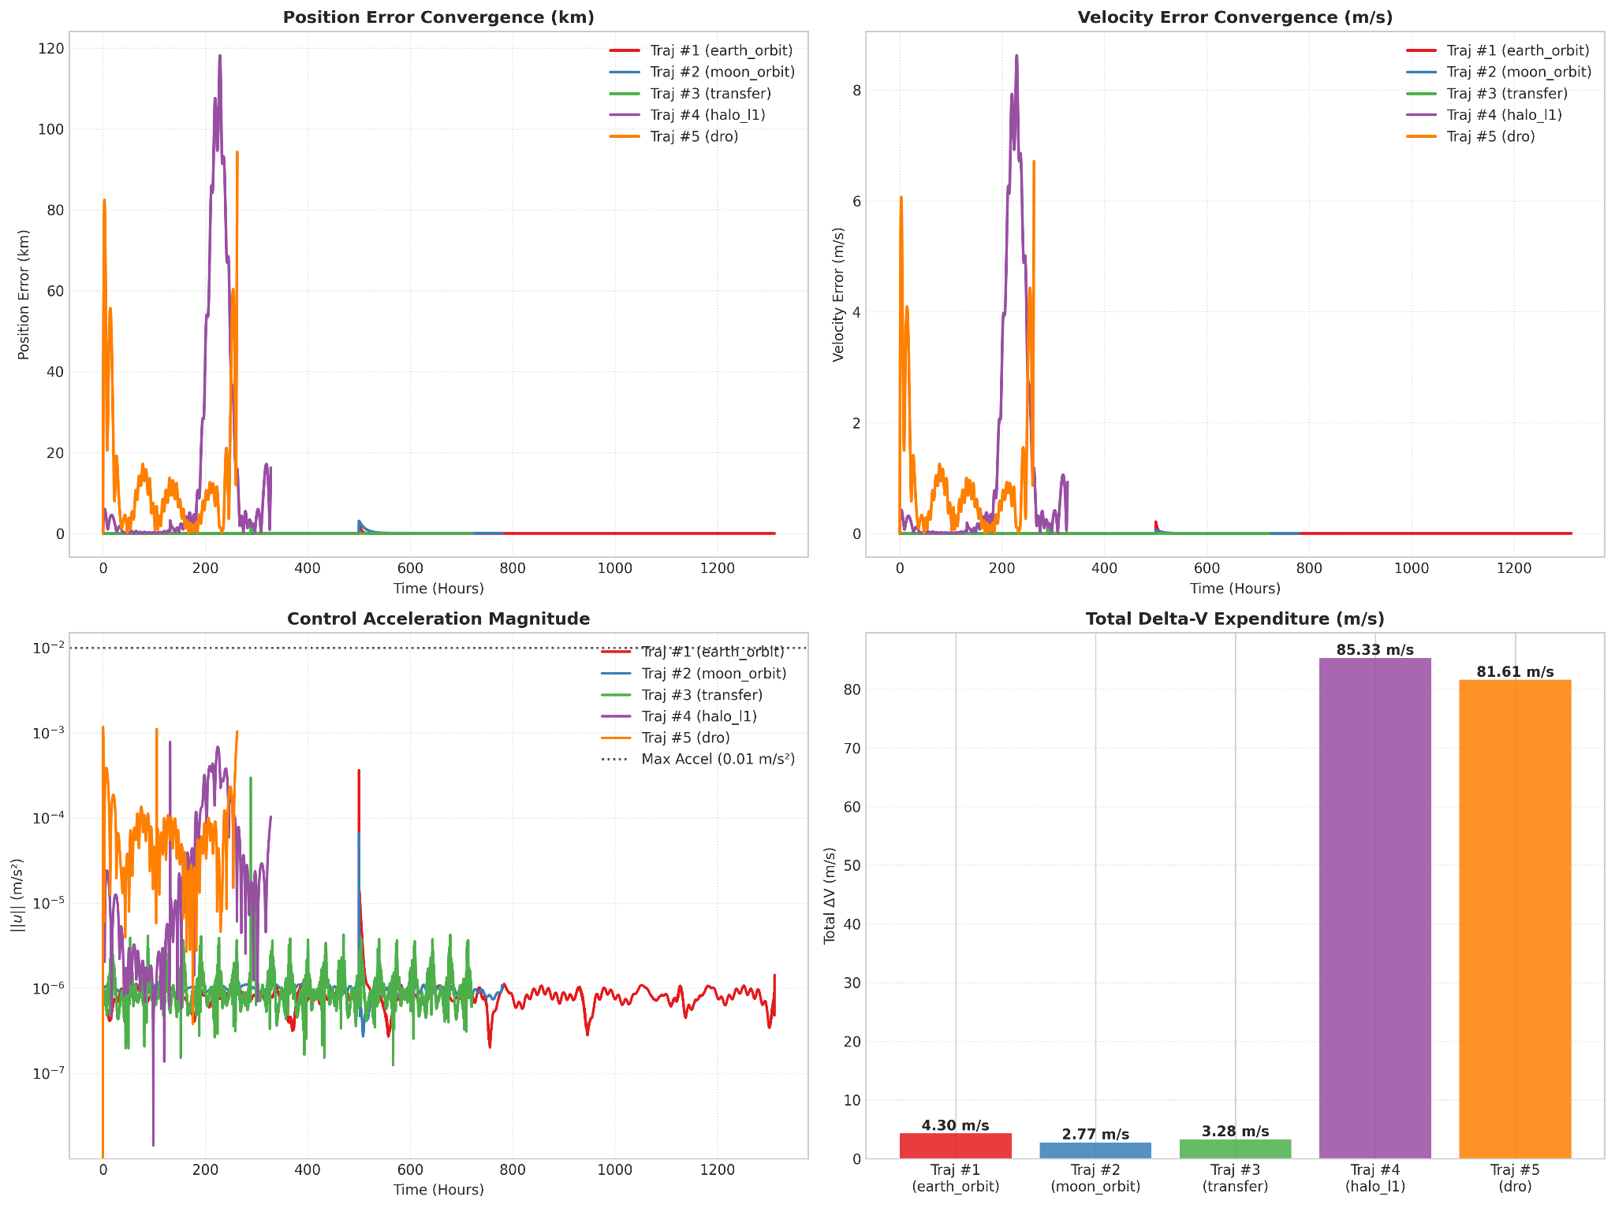
Cislunar Trajectory Classes
Multi-Regime Evaluation Environment
The simulation framework supports:
Earth Orbit
Moon Orbit
Earth–Moon Transfer
L1 Halo Orbit
L2 Halo Orbit
Distant Retrograde Orbit
Objective: Test whether one learned policy can generalize across substantially different dynamical environments.
ME 597 Independent Study
GRAINGER ENGINEERING

Slide 11
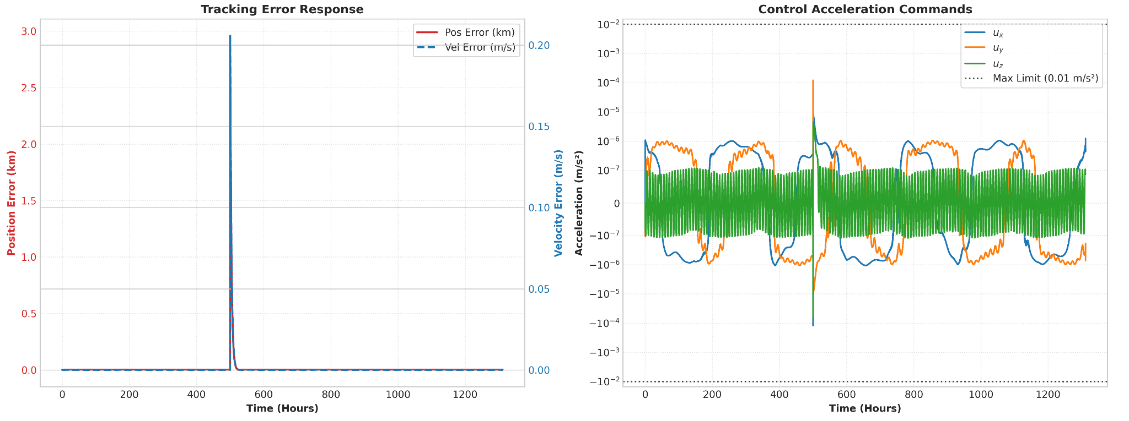
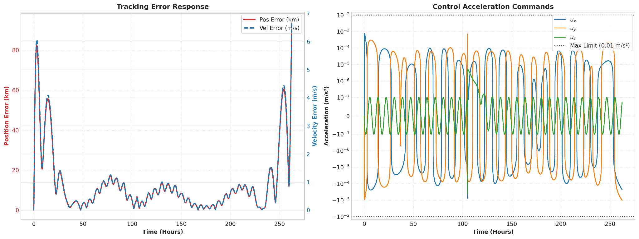
Controller Information Structure
PID-like Controller vs. Learned Policy
PID-like Controller Access:
Current spacecraft state
Reference trajectory
Tracking-error history
Integral state
Adaptive gains
Local instability information
Continuous feedback updates
LLM Access:
Current spacecraft state
Reference state
Tracking error
Mission context
ME 597 Independent Study
GRAINGER ENGINEERING

Slide 12
Natural Language Data Generation
Notes:
The purpose of this talk is to introduce the audience to your summer research project. Please practice for time, as you will have three minutes to complete your entire presentation.

Slide 13
Dataset Construction
Dataset Generation Pipeline
Generate nominal reference trajectories.
Inject controlled position and velocity disturbances.
Propagate recovery trajectories using the PID-like controller.
Store spacecraft state, reference state, mission context, and control action.
Convert numerical states and actions into structured language prompts and responses.
Trajectory/Perturbation → Spacecraft State/Control Input →Natural Language
ME 597 Independent Study
GRAINGER ENGINEERING

Slide 14
Dataset Size and Mission Coverage
Dataset Composition
600 complete spacecraft trajectories
1,311,089 supervised prompt-response pairs
Samples extracted using stride-two trajectory sampling.
Mission Distribution
Earth Orbit: 46.1%
Earth–Moon Transfer: 26.8%
Moon Orbit: 13.2%
L1 Halo: 9.5%
L2 Halo: 3.2%
DRO: 1.2%
ME 597 Independent Study
GRAINGER ENGINEERING

Slide 15
Natural-Language Representation
State-to-Text and Control-to-Text Conversion
Input Prompt Contains:
Cartesian position and velocity
Magnitude and direction information
Reference trajectory state
Position and velocity tracking errors
Mission progress and objective
Output Response Contains:
Three-axis acceleration vector
Magnitude and orientation
Canonical and physical units
{
"role": "assistant",
"content": "Command a continuous thrust acceleration vector of +8.9141e-07 m/s2 (0.000327 canonical units) along the X-axis, +1.2422e-06 m/s2 (0.000456 canonical units) along the Y-axis, and -7.2122e-08 m/s2 (-0.000026 canonical units) along the Z-axis. This applies a total physical thrust acceleration magnitude of 1.5306e-06 m/s2, oriented toward an azimuth of 54.3 degrees and an elevation of -2.7 degrees."
}
ME 597 Independent Study
GRAINGER ENGINEERING

Slide 16
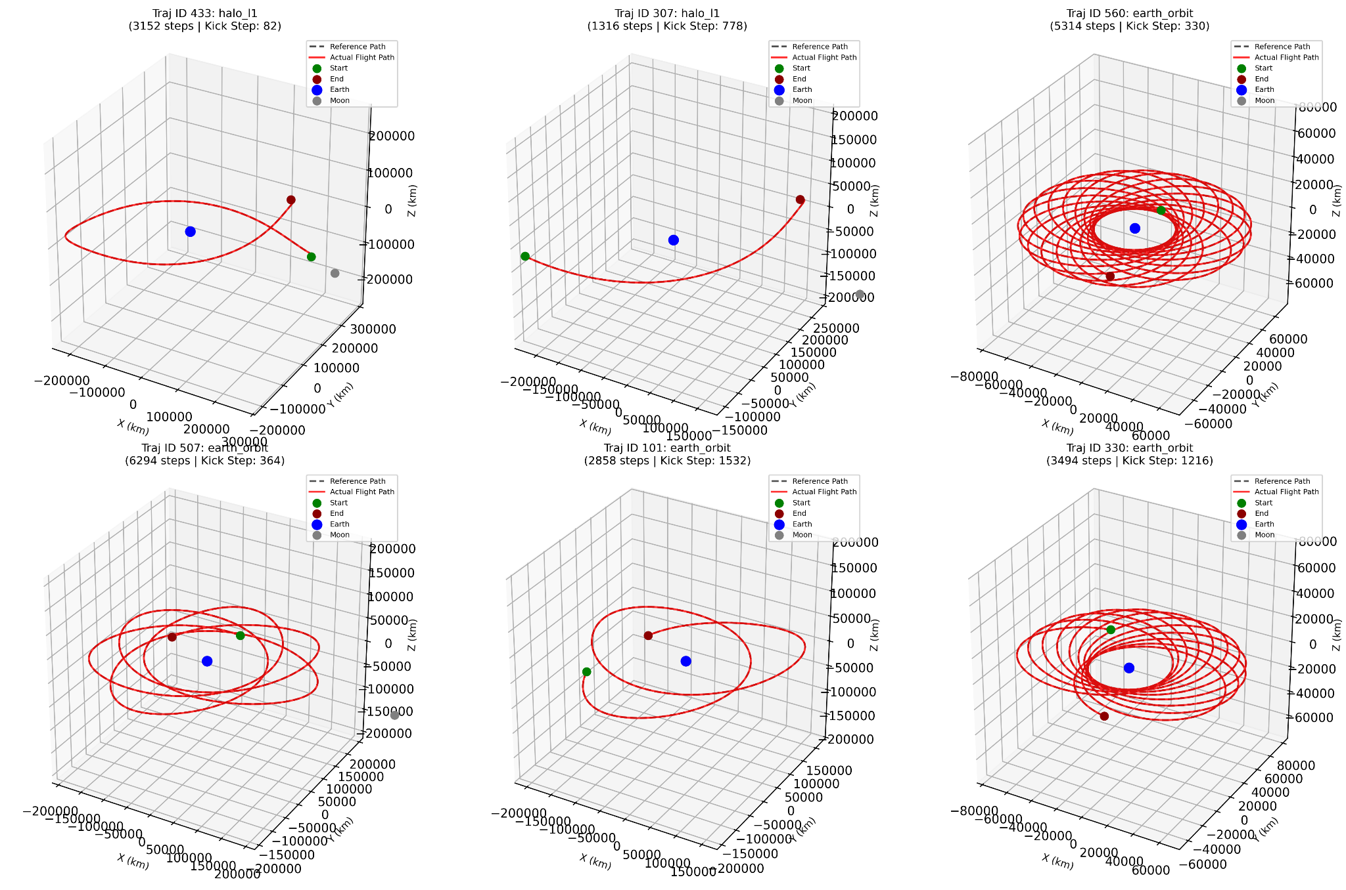
Dataset Verification
Verification of Demonstration Quality
Verification reconstructs trajectories from JSONL data and compares them against original PID-like simulations.
Mean discrepancy: 0.03 km
Median discrepancy: 0.01 km
Maximum discrepancy: 3.87 km
Conclusion: The dataset accurately preserves the PID-like guidance behavior used for training.
ME 597 Independent Study
GRAINGER ENGINEERING

Slide 17
LLM Training Performance
Notes:
The purpose of this talk is to introduce the audience to your summer research project. Please practice for time, as you will have three minutes to complete your entire presentation.

Slide 18
Model Fine-Tuning
Fine-Tuning Llama 3.1 8B Instruct for Spacecraft Guidance
The pretrained foundation model is adapted to reproduce the adaptive PID-like guidance policy.
Learning Objective
πFM:(x,xref,xerr,m,p)→u\pi_{FM}:(x,x_{ref},x_{err},m,p)\rightarrow uπFM​:(x,xref​,xerr​,m,p)→u
where:
x: Current spacecraft state
x_{ref}: Desired reference trajectory state
x_{err}: Tracking error information
m: Mission context
p: Mission progress
u: Continuous three-axis acceleration command
ME 597 Independent Study
GRAINGER ENGINEERING

Slide 19
Training Methodology
Supervised Instruction Fine-Tuning
Each trajectory sample is formatted as:
User Prompt
Describes spacecraft position and velocity
Provides reference trajectory information
Includes tracking error and mission objective
Assistant Response
Outputs required acceleration vector
Includes physical and canonical units
Optimization:
Hugging Face SFTTrainer
Causal language-modeling objective
Loss computed only on completion tokens
Prompt tokens excluded using response-template masking
Key Point: The model learns to reproduce control decisions, not directly minimize spacecraft trajectory error.
ME 597 Independent Study
GRAINGER ENGINEERING

Slide 20
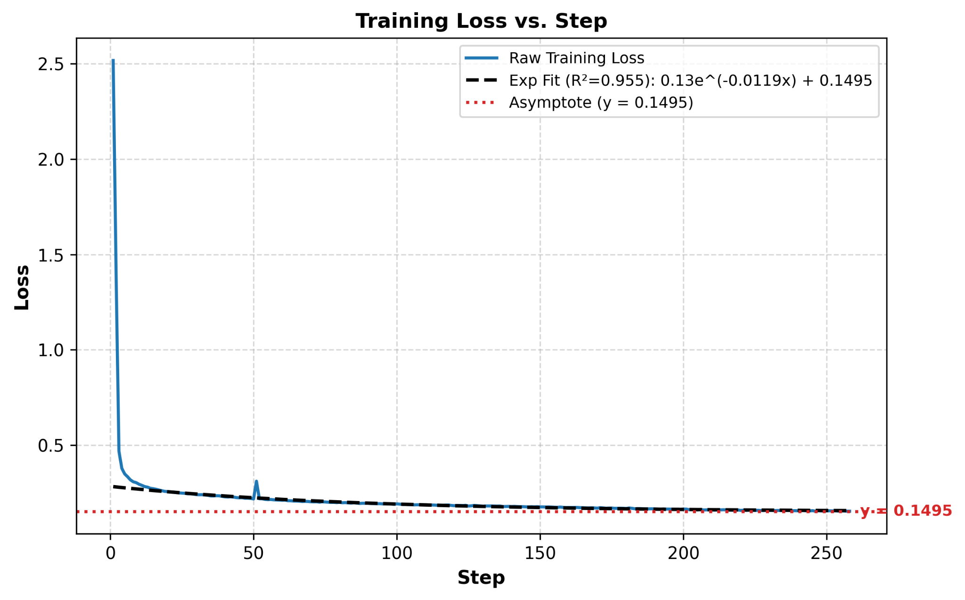
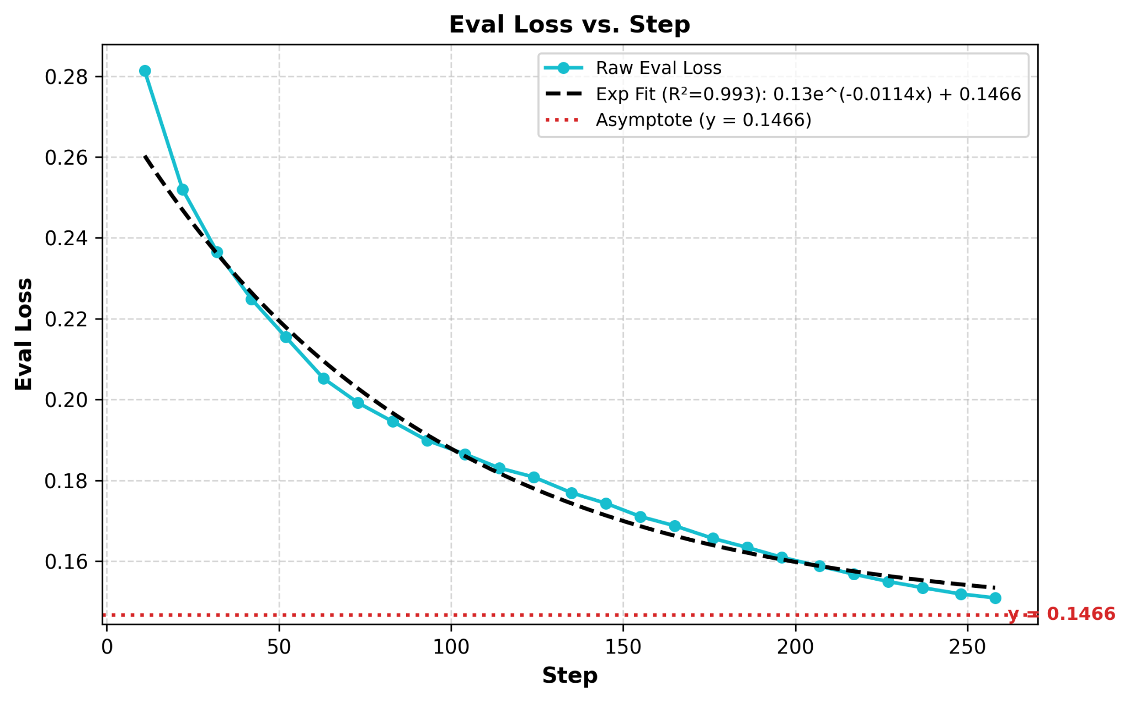
Training Configuration and Convergence
Fine-Tuning Configuration
Dataset: 1,311,089 samples
Train/Evaluation Split: 95% / 5%
Maximum Sequence Length: 512 tokens
Learning Rate: \(2\times10^{-4}\)
Effective Batch Size: 32
Precision: bfloat16
Training: 2.57 epochs
Training Behavior:
Stable loss decrease
No evidence of significant overfitting:
Training Loss Fit: R2 = 0.9552 with an estimated asymptotic limit of 0.1495.
Evaluation Loss Fit: R2 = 0.9926 with an estimated asymptotic limit of 0.1466.
ME 597 Independent Study
GRAINGER ENGINEERING

Slide 21
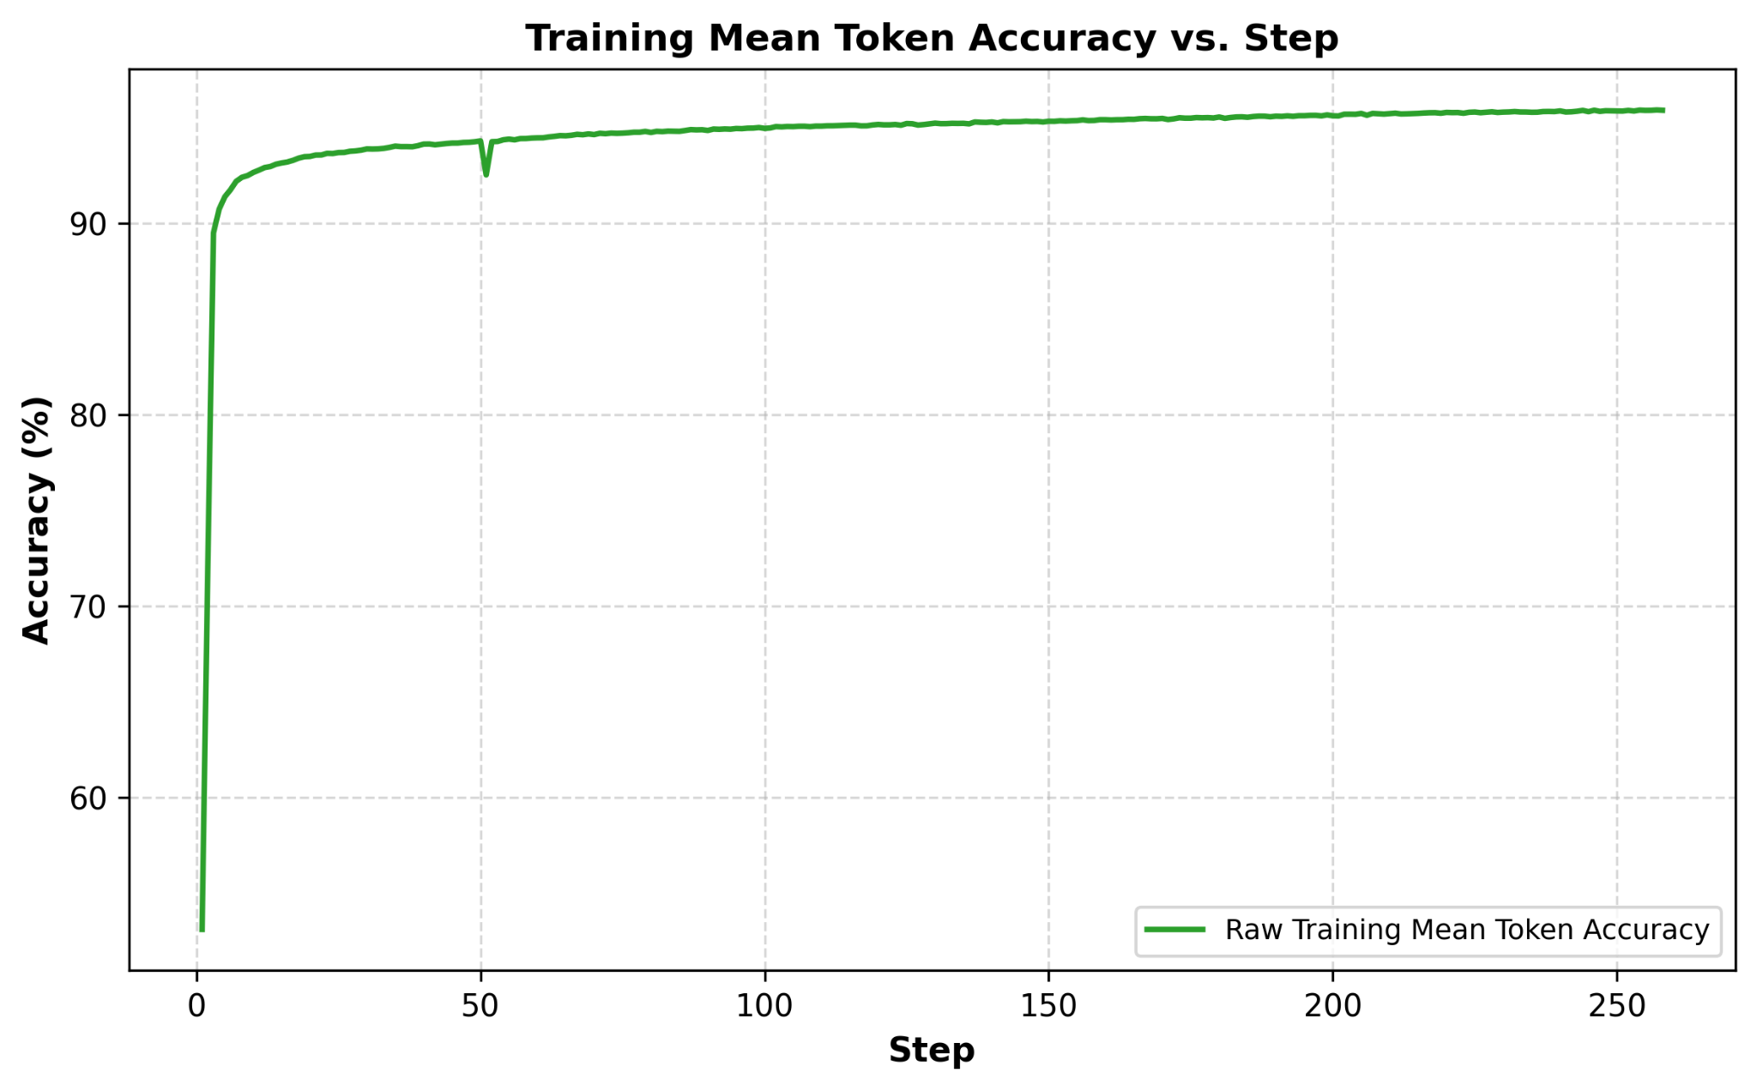
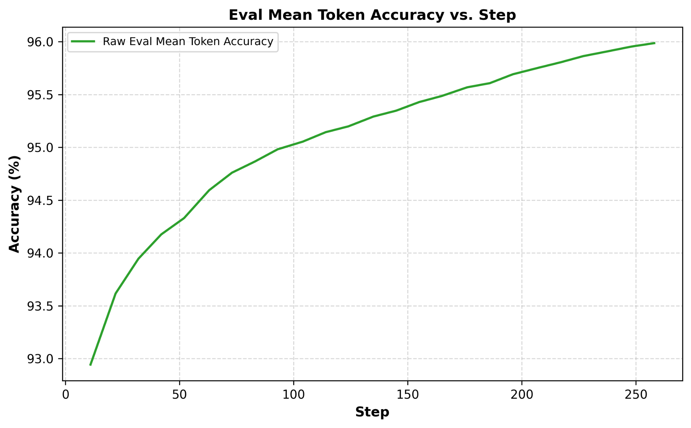
Fine-Tuning Performance
Successful Language-Level Imitation
Final Metrics:
Training Loss: 0.1526
Evaluation Loss: 0.1509
Training Token Accuracy: 95.91%
Evaluation Token Accuracy: 95.99%
Interpretation:
The model learned spacecraft-state descriptions.
The model learned mission-conditioned output structure.
The model reproduced the formatting and numerical patterns of PID-like commands.
ME 597 Independent Study
GRAINGER ENGINEERING

Slide 22
Closed-Loop LLM Evaluation
Notes:
The purpose of this talk is to introduce the audience to your summer research project. Please practice for time, as you will have three minutes to complete your entire presentation.

Slide 23
Closed-Loop Evaluation Architecture
Deploying the LLM as a Spacecraft Feedback Controller
The fine-tuned LLM is integrated directly into the spacecraft simulation loop.
Control Cycle
Measure spacecraft state
Generate mission-aware prompt
Perform LLM inference
Extract acceleration command
Apply safety conditioning
Propagate disturbed CRTBP dynamics
Repeat guidance update
Evaluation Goal: Determine whether learned language-based guidance reproduces closed-loop PID-like controller behavior.
ME 597 Independent Study
GRAINGER ENGINEERING

Slide 24
LLM Command Processing and Safety Conditioning
Converting Text Output into Physical Control
The generated response passes through:
Command Parsing: Extract X, Y, and Z acceleration components.
Validation: Enforce physical acceleration limits.
Fallback Handling: Maintain previous valid command if parsing fails.
Smoothing: Apply exponential filtering.
Rate Limiting: Restrict rapid command changes.
Maximum acceleration constraint:
∣∣u∣∣≤0.01 m/s2||u||\leq0.01~m/s^2∣∣u∣∣≤0.01 m/s2
Important: Safety conditioning prevents invalid commands but does not stabilize incorrect predictions.
ME 597 Independent Study
GRAINGER ENGINEERING

Slide 25
Closed-Loop Evaluation Setup
Testing Across Cislunar Mission Classes
The LLM controller was evaluated on:
Earth Orbit
Moon Orbit
Earth–Moon Transfer
L1/L2 Halo Orbits
Distant Retrograde Orbit
Simulation Conditions:
Same disturbance model as training
Injected position and velocity perturbation
Sampled-data LLM control updates
Continuous nonlinear CRTBP propagation
Metrics:
Position error
Velocity error
Acceleration magnitude
Total ΔV
Command validity
ME 597 Independent Study
GRAINGER ENGINEERING

Slide 26
LLM Performance
Notes:
The purpose of this talk is to introduce the audience to your summer research project. Please practice for time, as you will have three minutes to complete your entire presentation.

Slide 27
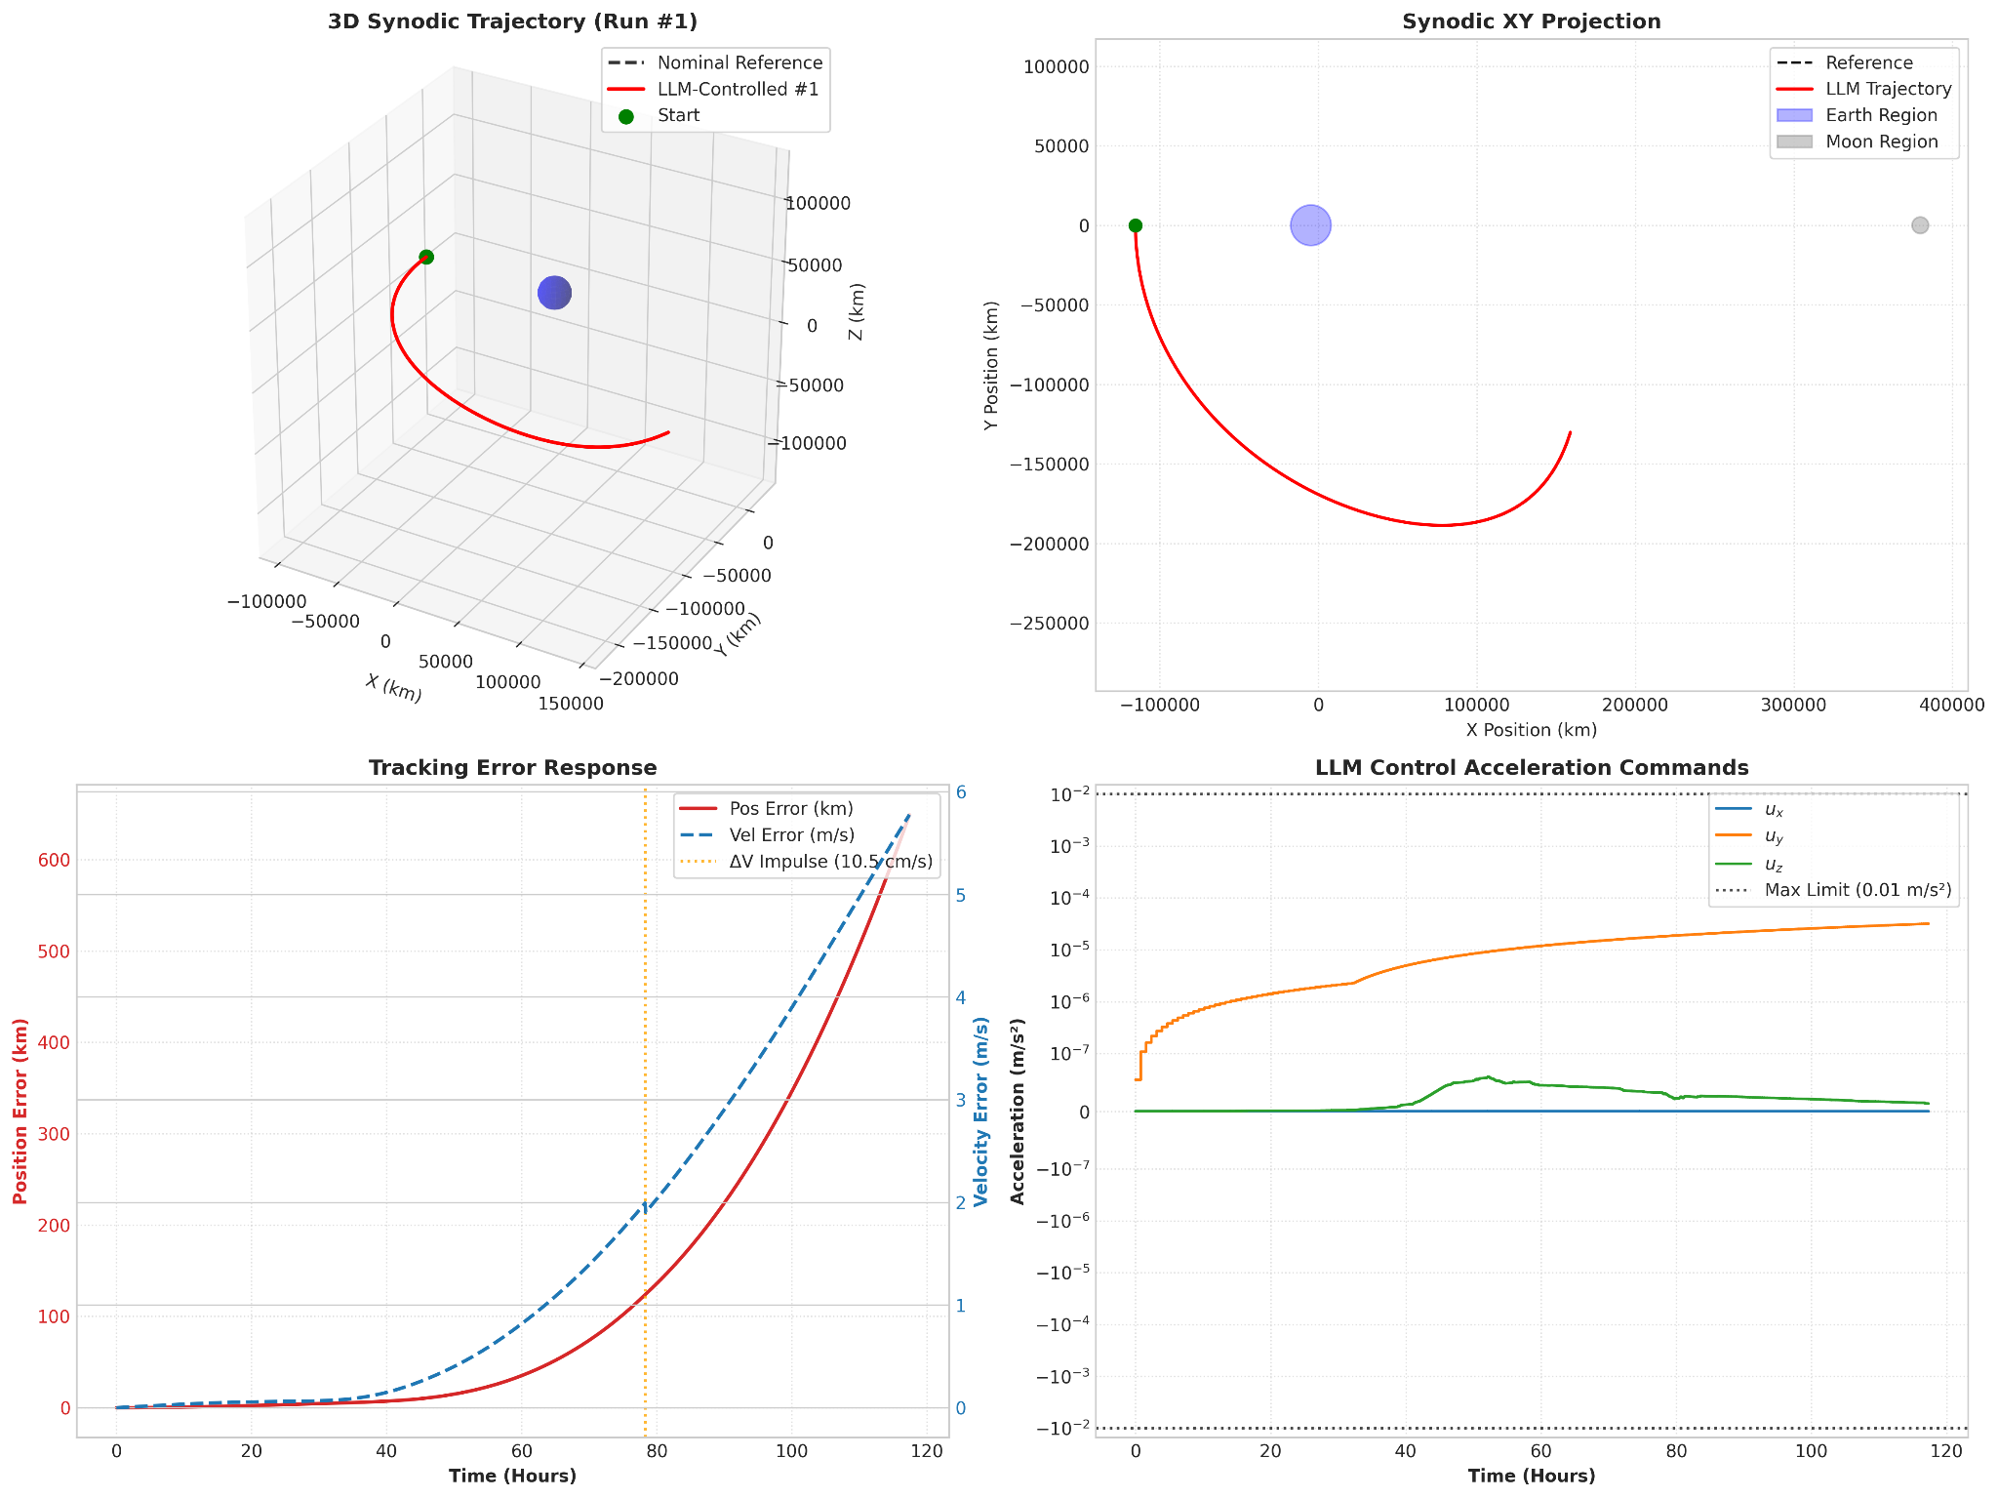
Trajectory 1 Earth-Moon Transfer
ME 597 Independent Study
GRAINGER ENGINEERING

Slide 28
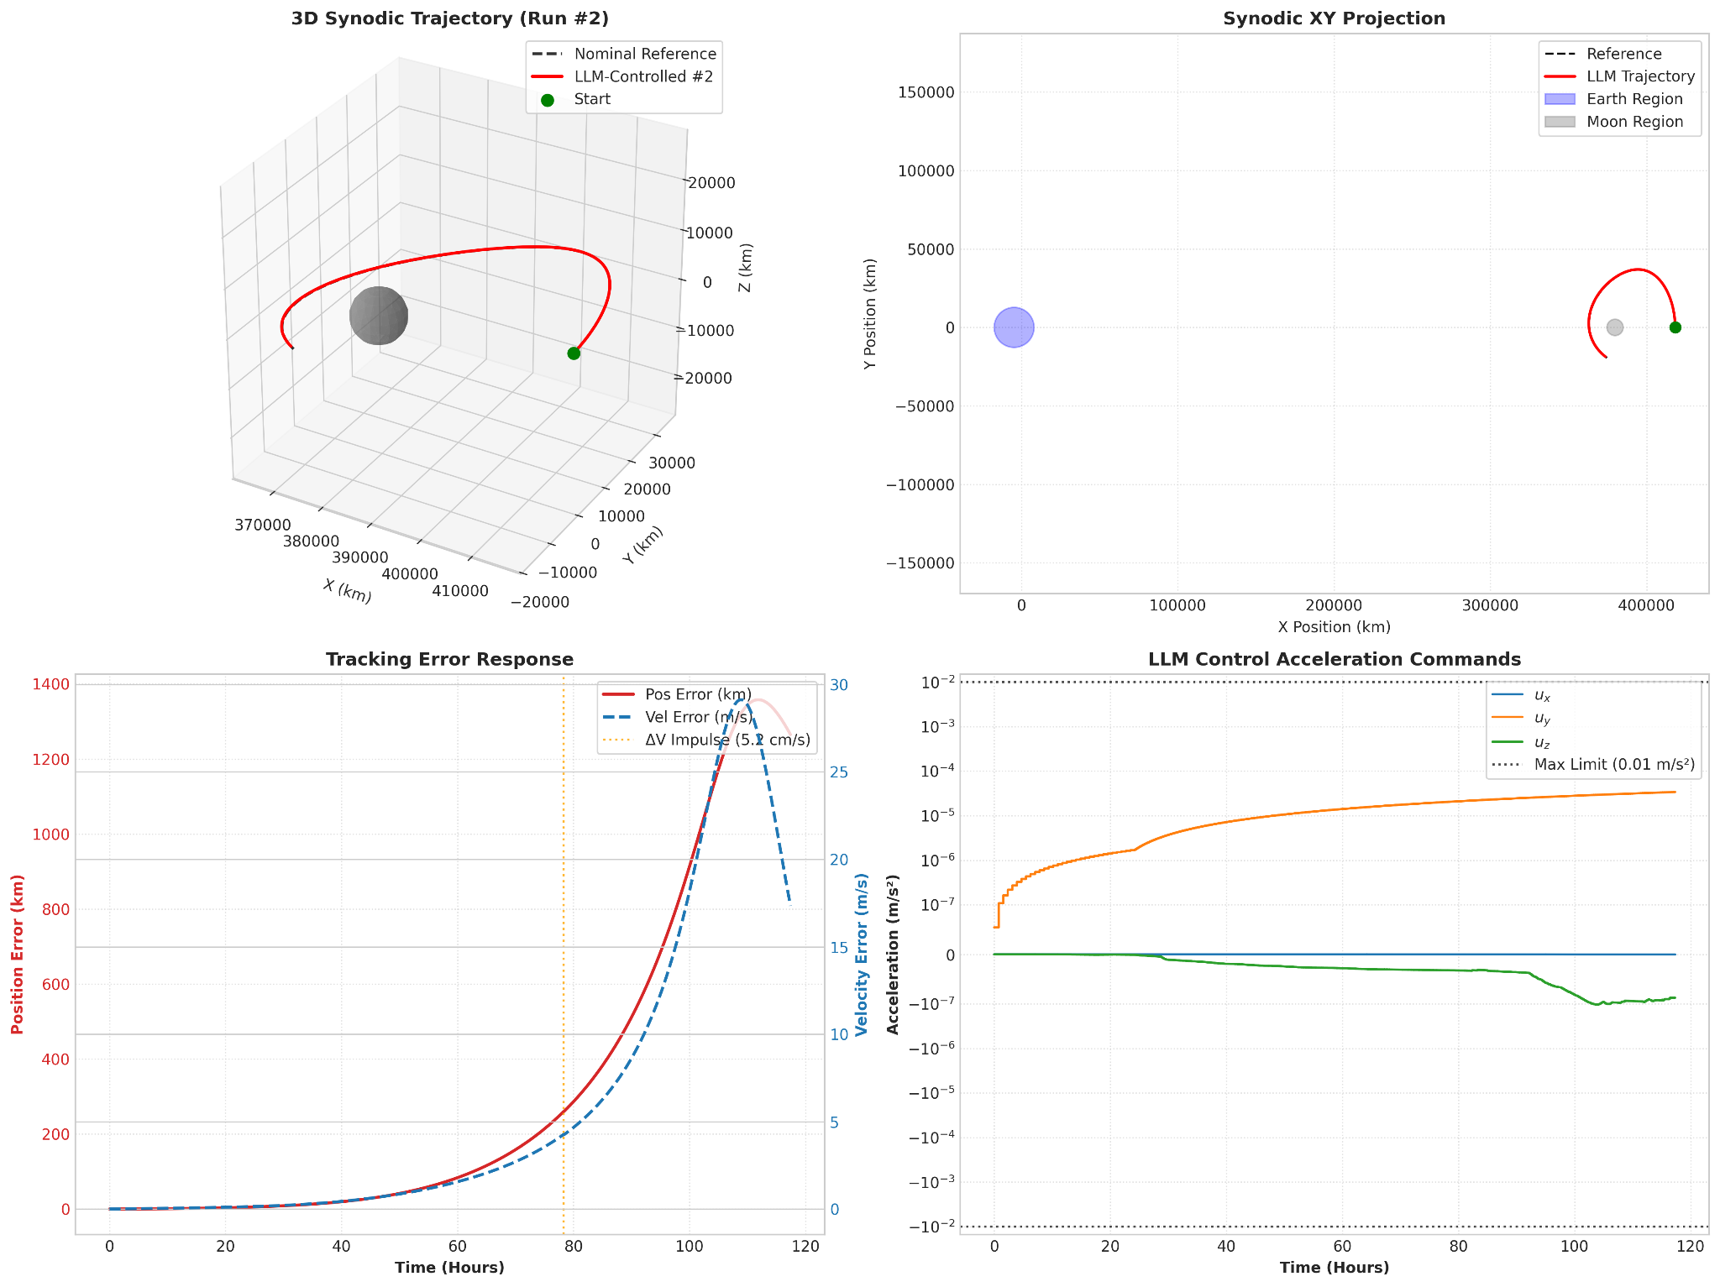
Trajectory 2 DRO
ME 597 Independent Study
GRAINGER ENGINEERING

Slide 29
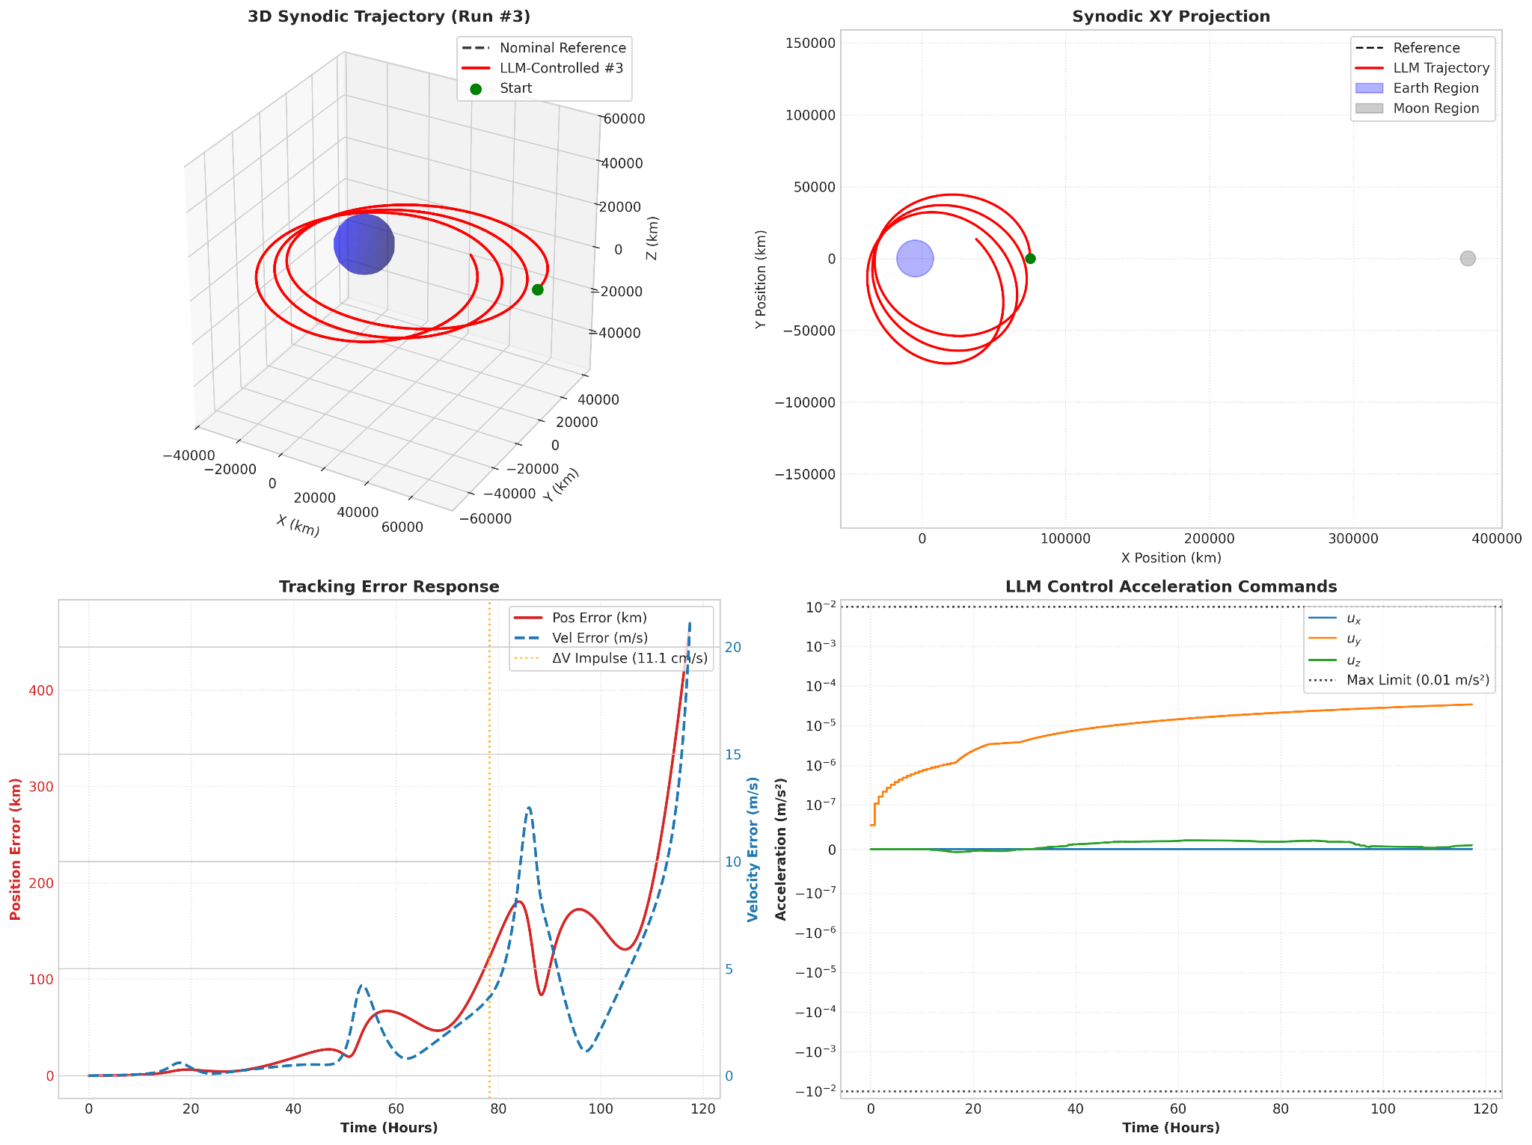
Trajectory 3 Earth Orbit
ME 597 Independent Study
GRAINGER ENGINEERING

Slide 30
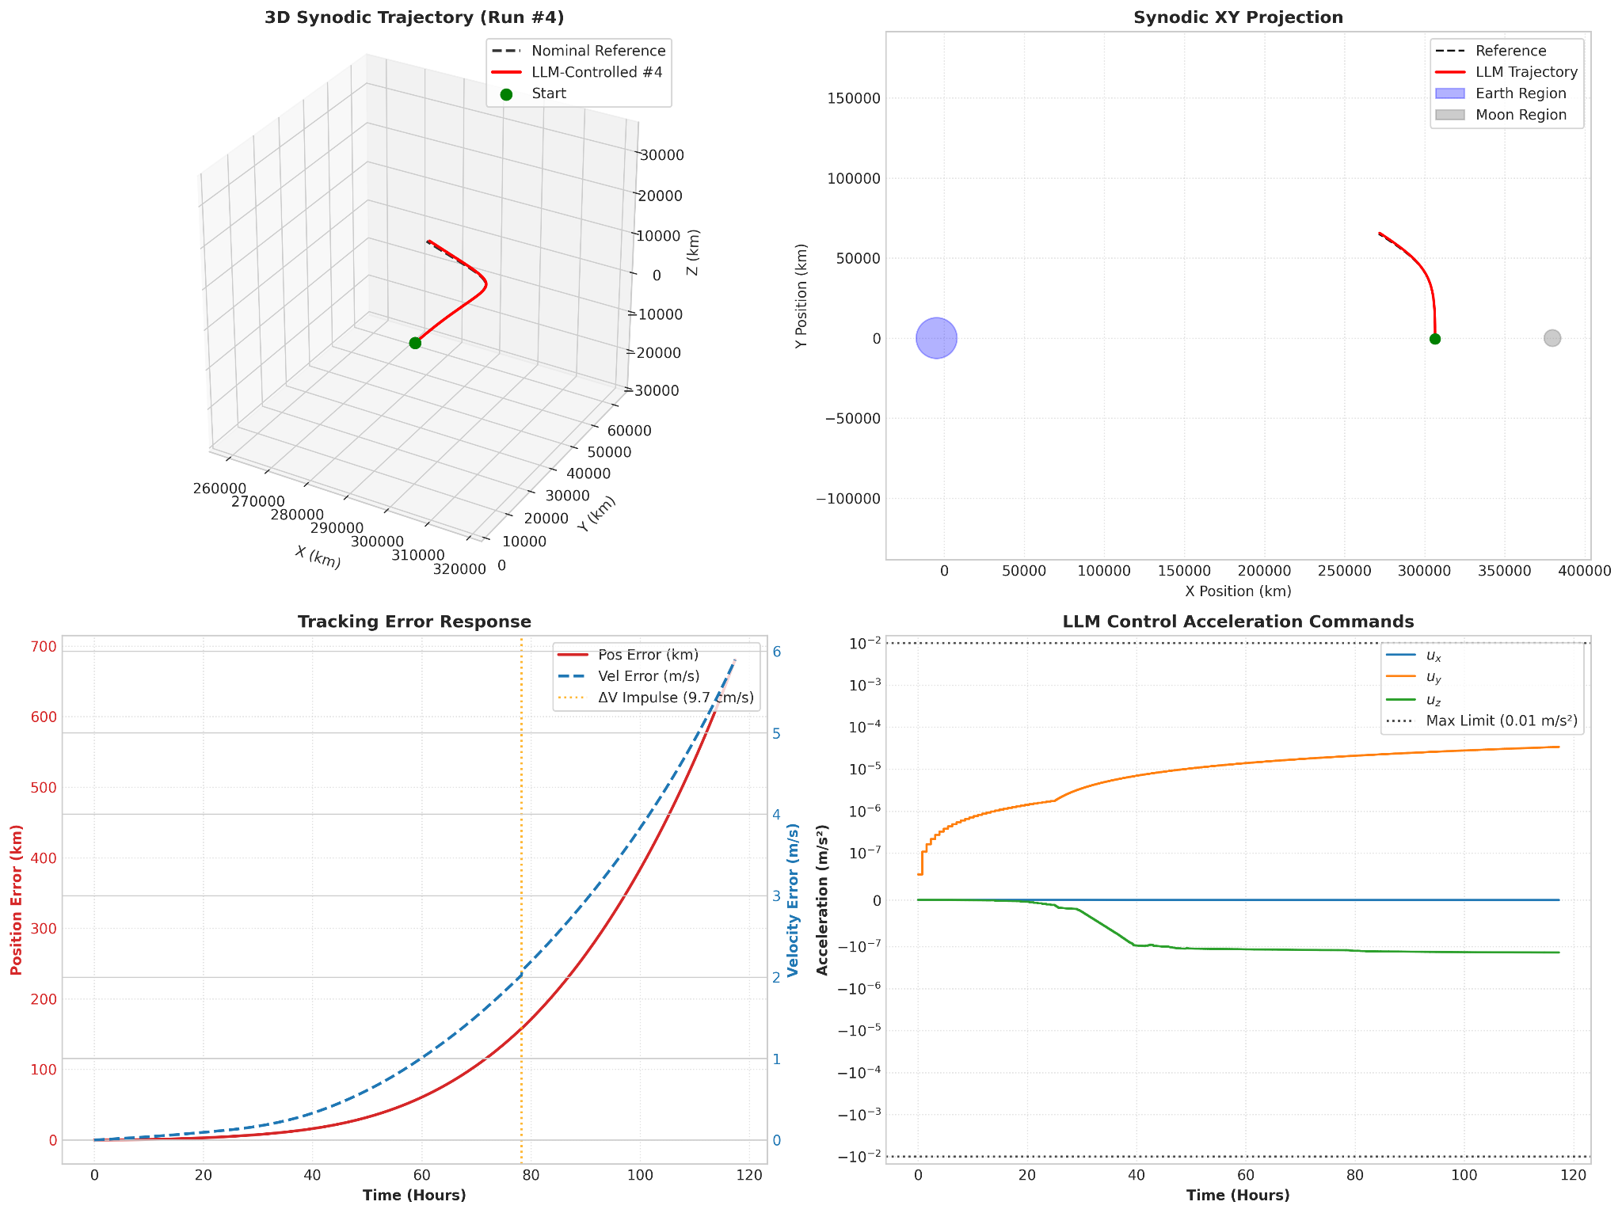
Trajectory 4 L1 Halo
ME 597 Independent Study
GRAINGER ENGINEERING

Slide 31
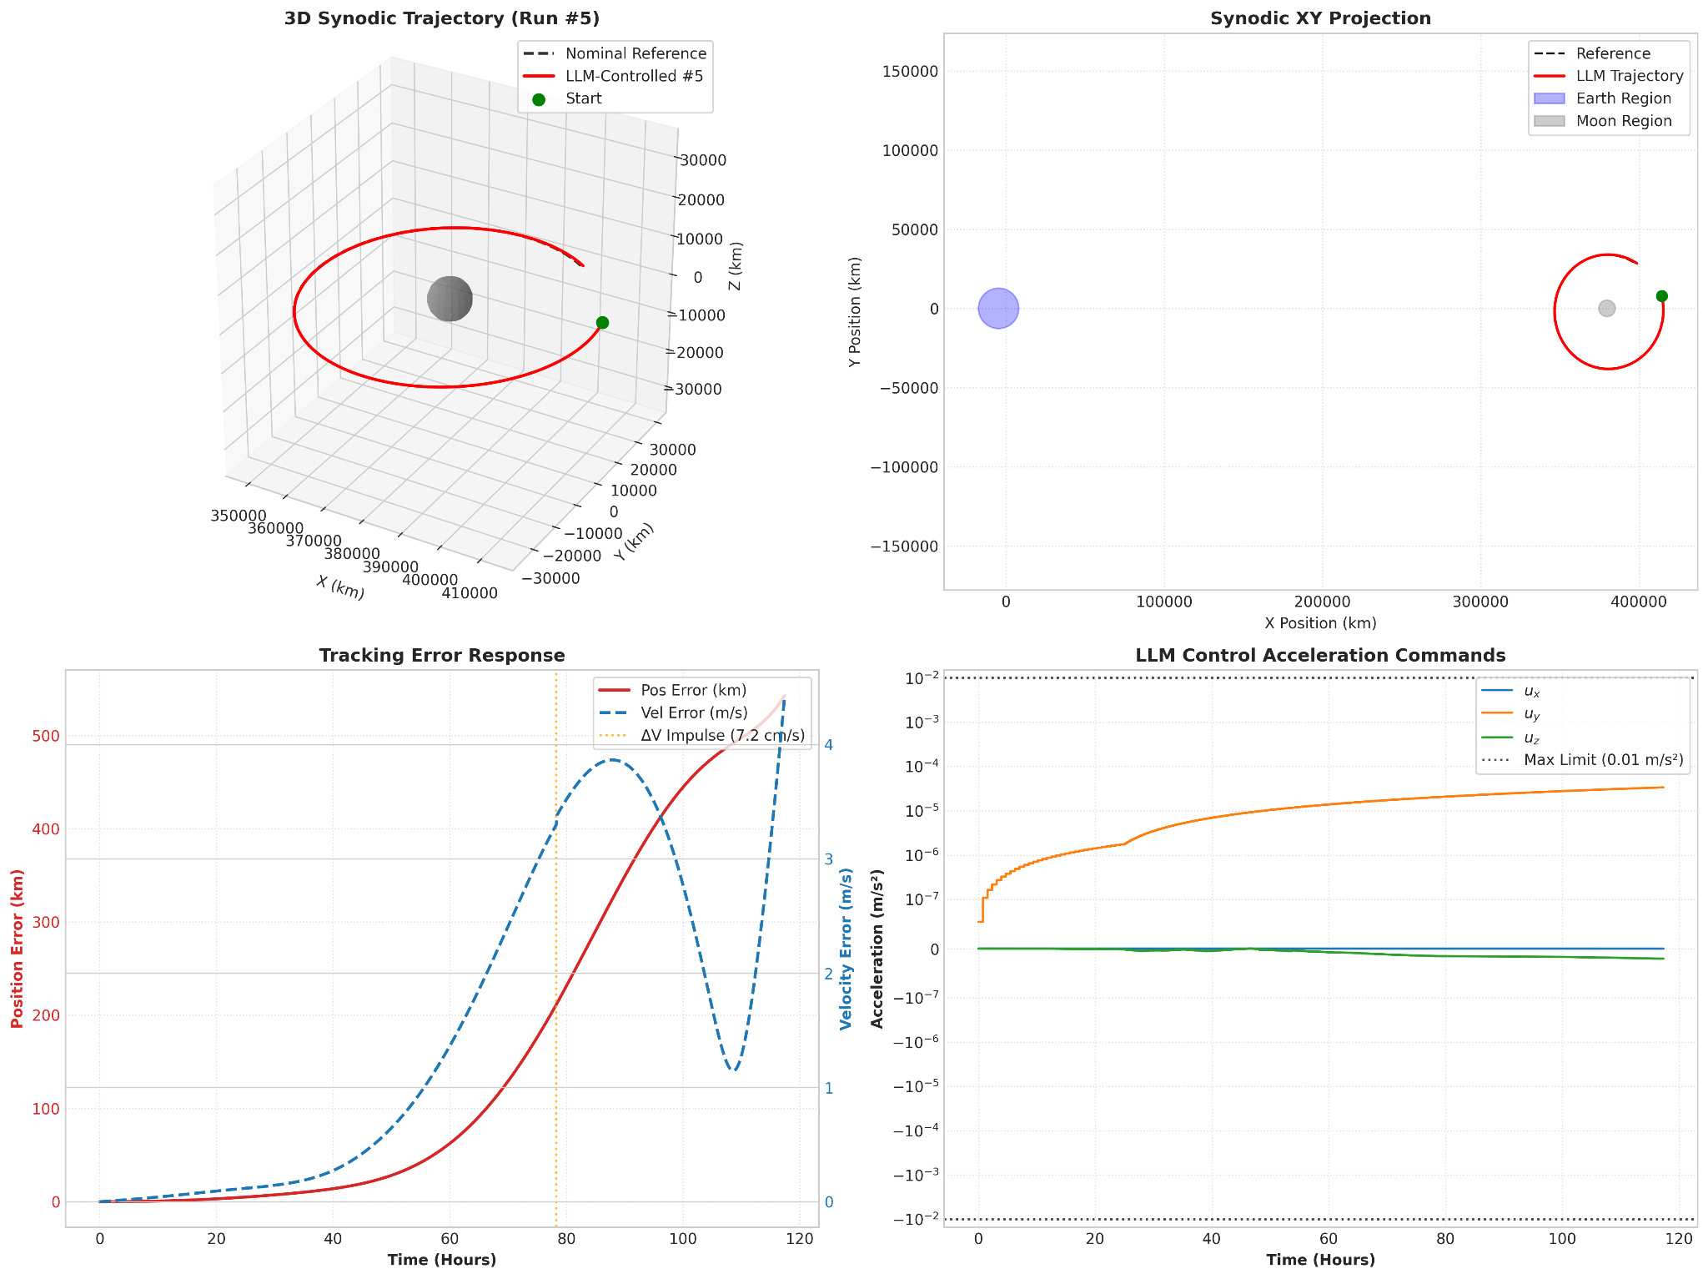
Trajectory 5 Moon Orbit
ME 597 Independent Study
GRAINGER ENGINEERING

Slide 32
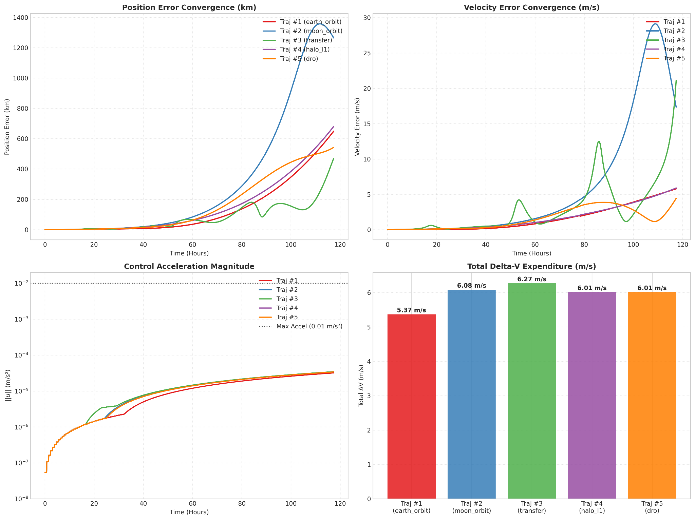
LLM Closed-Loop Results
Trajectory Tracking Performance
Final position errors:
Earth Orbit: 500 km
Moon Orbit: 1338 km
Earth–Moon Transfer: 189 km
L1 Halo: 533 km
DRO: 496 km
Observation:
The LLM generated bounded and physically valid commands.
The spacecraft trajectories remained numerically bounded.
Tracking errors increased following disturbances.
ME 597 Independent Study
GRAINGER ENGINEERING

Slide 33
Discussion and Future Work
Notes:
The purpose of this talk is to introduce the audience to your summer research project. Please practice for time, as you will have three minutes to complete your entire presentation.

Slide 34
PID-like VS LLM Control
PID-like Controller:
Uses accumulated error history
Maintains an integral state
Adapts gains based on local instability
Continuously updates feedback behavior
LLM Controller:
Uses instantaneous state information
Does not observe hidden controller states
Lacks explicit temporal memory
Uses lower-frequency sampled inference
Main Finding: The language representation captured observable spacecraft conditions but did not encode the complete information structure governing adaptive control decisions.
ME 597 Independent Study
GRAINGER ENGINEERING

Slide 35
Conclusions
Key Conclusions
Framework Development: A complete Earth–Moon CRTBP framework was developed integrating nonlinear propagation, adaptive PID-like guidance, natural-language dataset generation, LoRA fine-tuning, and closed-loop LLM evaluation.
Language Representation: The Llama 3.1 8B Instruct model successfully learned a structured mapping between spacecraft state descriptions, mission context, and continuous acceleration commands using over 1.31 million prompt-response examples.
Imitation Performance: Fine-tuning achieved approximately 96% held-out token accuracy, demonstrating that the model learned the language representation of the PID-like controller.
Closed-Loop Performance: The LLM generated physically valid and bounded commands across multiple cislunar trajectory classes, but trajectory errors increased after disturbance injection.
Primary Finding: Learning a state-to-action mapping is not sufficient to reproduce an adaptive nonlinear controller when critical internal variables, temporal information, and feedback states are not represented.
ME 597 Independent Study
GRAINGER ENGINEERING

Slide 36
Future Work
Beyond Imitation Learning
Reinforcement learning
Trajectory-error optimization
Safety-constrained training objectives
Higher-Fidelity Validation
Ephemeris-based dynamics
Navigation uncertainty
Improving LLM-Based Spacecraft Guidance
Controller-State Representation
Include integral state
Include adaptive gains
Include instability metrics
Include previous commands and uncertainty states
Dataset Improvements
Increase halo and DRO representation
Include larger disturbance scenarios
Expand recovery-state coverage
ME 597 Independent Study
GRAINGER ENGINEERING

Slide 37
Work Cited
[1] Prussing, J. E., and Conway, B. A., Orbital Mechanics, Oxford University Press, New York, 1993.
[2] Lavretsky, E., and Wise, K. A., Robust and Adaptive Control: With Aerospace Applications, Springer-Verlag, London, 2012.
[3] Zucchelli, E. M., Wu, D., Briden, J., Hofmann, C., Rodriguez-Fernandez, V., and Linares, R., "Fine-Tuned Language Models as Space Systems Controllers," arXiv preprint arXiv:2501.16588, 2025.
[4] Meta AI, "Llama 3.1 8B Instruct," 2024, URL: https://huggingface.co/meta-llama/Llama-3.1-8B-Instruct [accessed 25 Aug. 2026].
[5] Hugging Face, "TRL: Transformer Reinforcement Learning Library and SFTTrainer Documentation," 2024, URL: https://huggingface.co/docs/trl/sft_trainer [accessed 25 Aug. 2026].
[6] National Center for Supercomputing Applications, "Delta Advanced Computing and Data Resource," 2022, URL: https://delta.ncsa.illinois.edu.
[7] Advanced Cyberinfrastructure Coordination Ecosystem: Services and Support, "ACCESS Advanced Computing and Data Resources," 2024, URL: https://access-ci.org.
ME 597 Independent Study
GRAINGER ENGINEERING
Notes:
You can use this slide to thank you mentors and other collaborators. End the presentation by thanking the audience for their attention and ask if there are any questions.

